Slide 1

IOT Smart Drone
Peidong Chen, Yitian Hu, Yang Yang, Jiayu Guo
Advisor: Prof. William Kaiser
EE202C Networked Embedded Systems Design Midterm
Notes:
introduce group members

Slide 2
Mid-term Progress Presentation
Background and Mission
Design Overview
Technical Details:
a. Drone system
b. IOT functionality
Test & Verification
Future Plan
Team Responsibility & Reference Resource
Notes:
today's presentation would include these following things->
why iot drone?
issues to solve and difficulties
focus on technical details
test reliability and performance /show demo

Slide 3
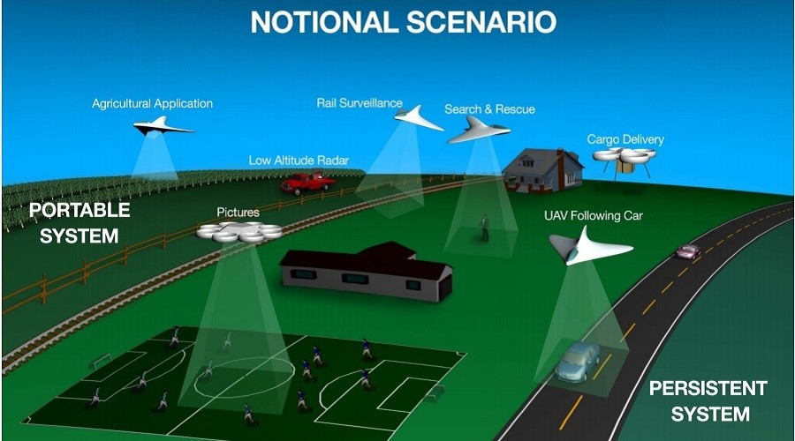
Product Development Mission Background: Flying nodes
Flying hotspot (agriculture)
Logistics ( Amazon delivery)
Real-time Traffic& security monitoring
"Dr. Parimal Kopardekar, the manager of NASA's NexGen concepts and technology development project"
Notes:
This network system is also likely to be cloud-based,
meaning that drones will need an internet link to download information
about weather, logistics, traffic((flow speed) and restricted zones.​

Slide 4
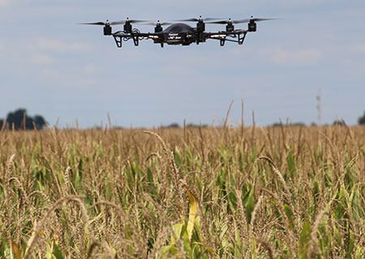
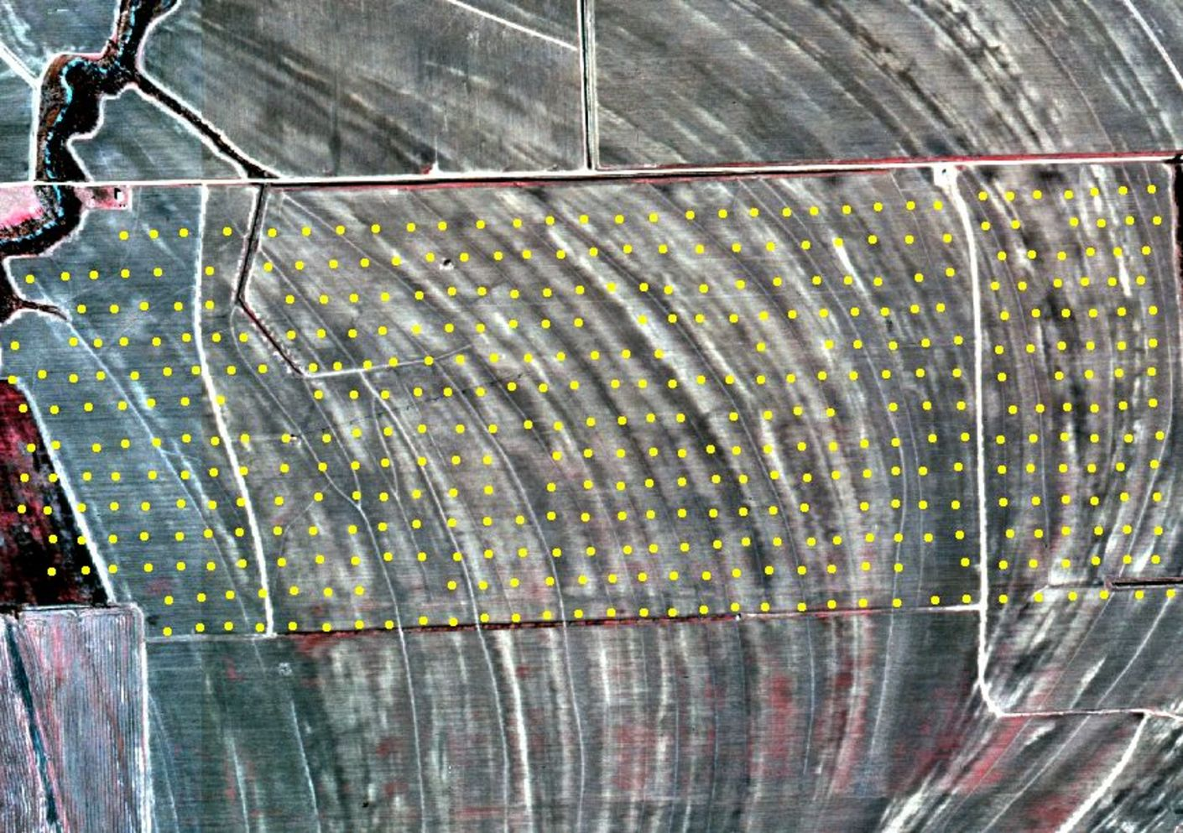
Flying hotspot
Product Development Mission Background: Flying nodes
http://hplusmagazine.com/2015/03/19/future-farming/
Notes:
For farms, we always do not have wifi access to outdoor sensors and gateways.

Slide 5
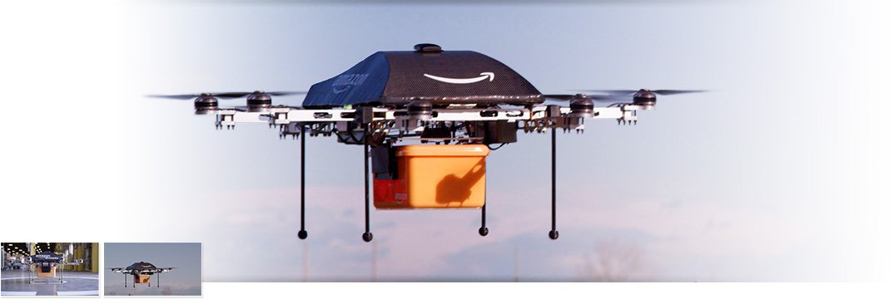
Logistics
Product Development Mission Background: Flying nodes
Amazon drone

Slide 6
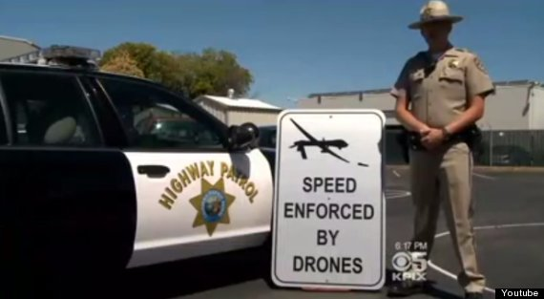
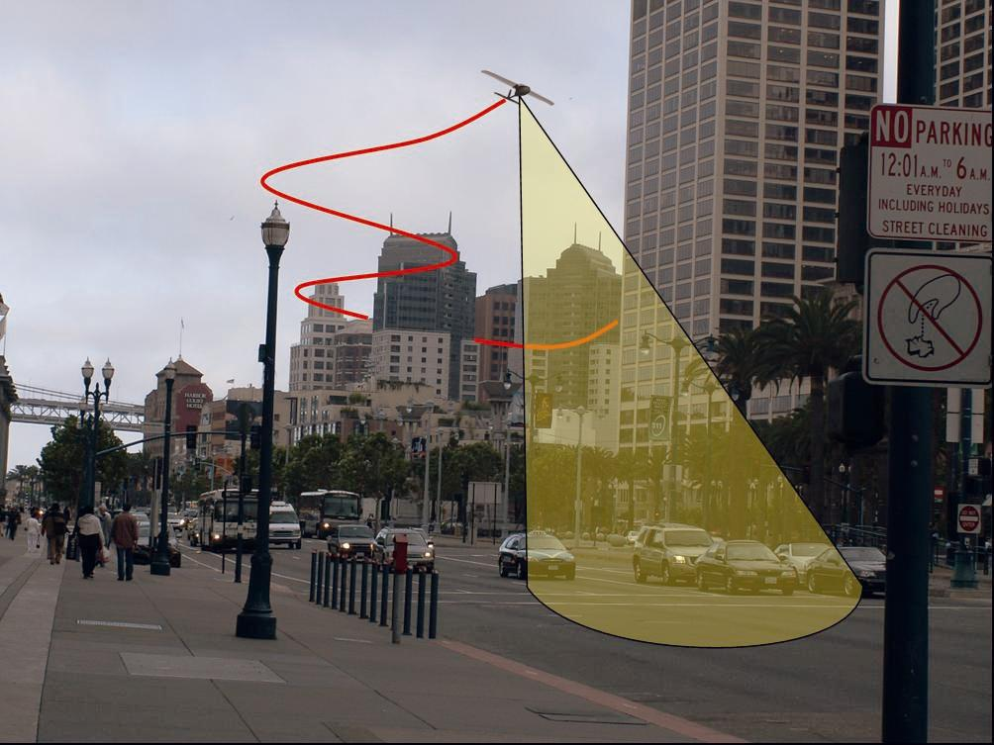
Product Development Mission Background: Flying nodes
Traffic monitoring
UAV Monitoring Traffic
A police officer stands next to a fake "Speed Enforced By Drones" sign found on a California highway.

Slide 7
Design Overview: Technical Challenges
Detailed Problem Statement
Battery life time & Power consumption
Alleviated by charge station information on the Internet
Data transmission online
Whether real-time and high-speed
Drone reliability and safety with multi-functionality
Test by building a drone by ourselves

Slide 8
System Architecture
Drone system
PWM generation
Gyroscope detection
IOT functionality
Cloud server data analyzing
Evasion avoidance
Ultrasonic sensor
PID controller
Image Processing
Auto navigation

Slide 9
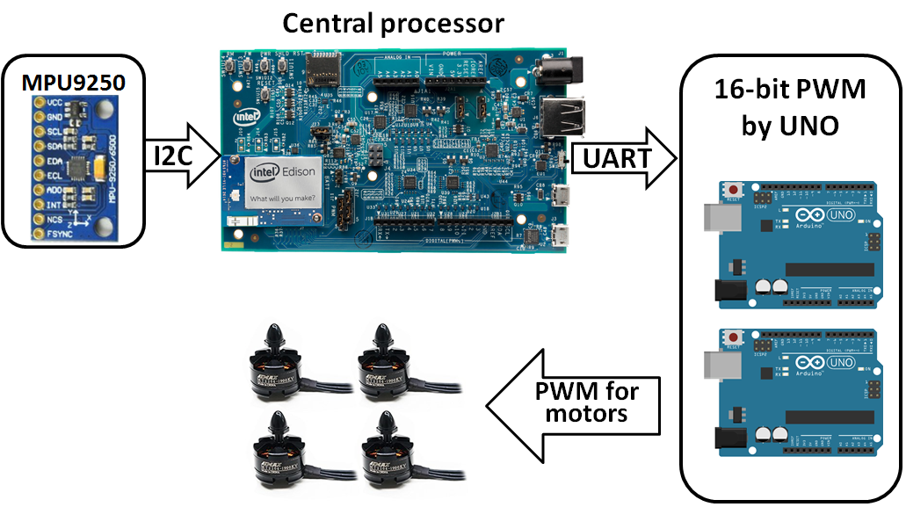
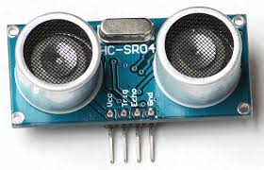
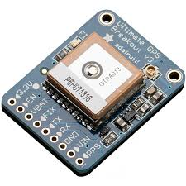
Drone system
I2C issues in Yocto >= 2.1
GPIO
uart
GPS ultimate adafruit
Notes:
PWM signal in Edison cannot provide a resolution higher than 8bits, which is only equal to 12 levels for motors.

Slide 10
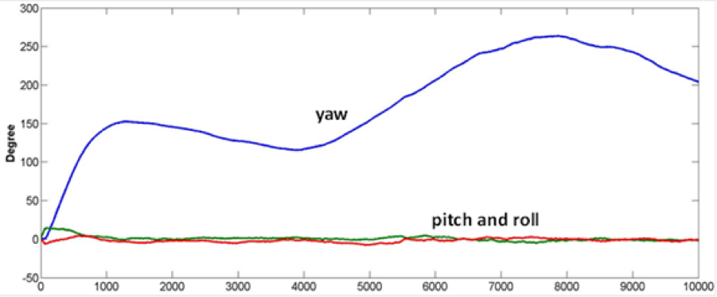
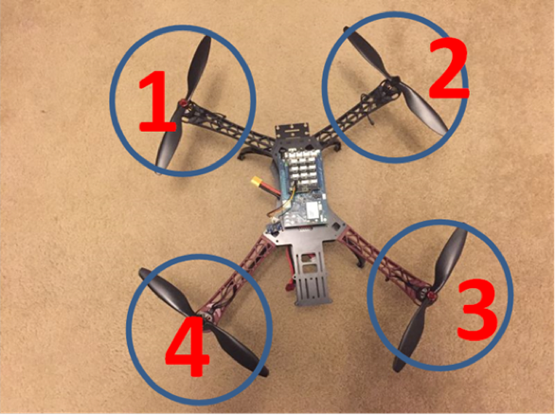
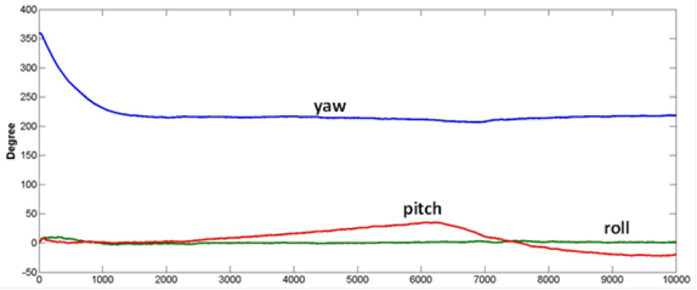
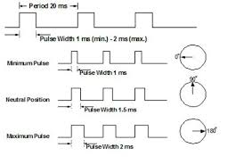
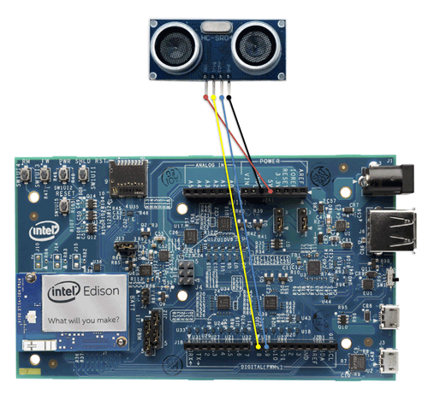
Design Overview: Technical Approach
Detailed Approach: hardware
Madgwick AHRS
Installment
9dof sensor
PMW generation
Ultrasonic sensor

Slide 11
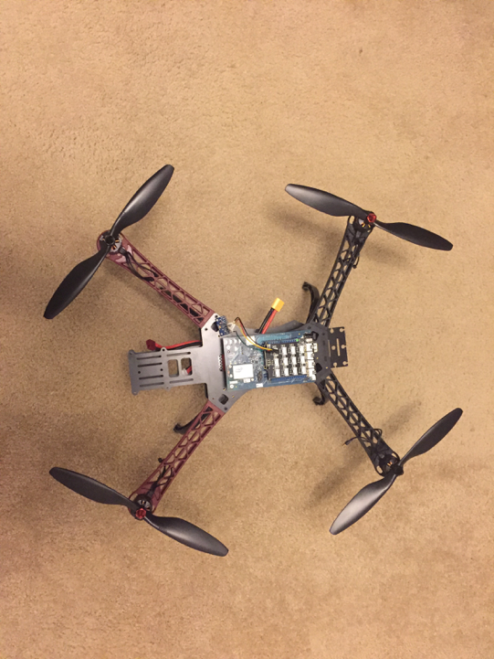
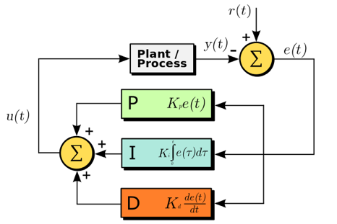
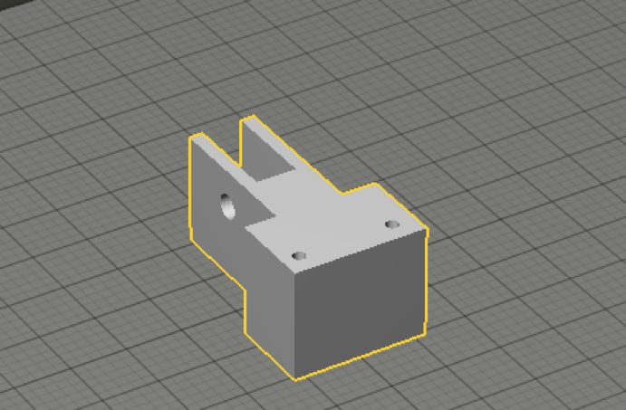
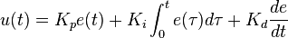
Design Overview: Technical Approach
Detailed Approach: hardware
PID controller
3D printing protector and connector
PID controller
3Dprinting
Notes:
In this model, P accounts for present values of the error (e.g. if the error is large and positive, the control output will also be large and positive), I accounts for past values of the error (e.g. if the output is not sufficient to reduce the size of the error, error will accumulate over time, causing the controller to apply stronger output), and D accounts for predicted future values of the error, based on its current rate of change

Slide 12
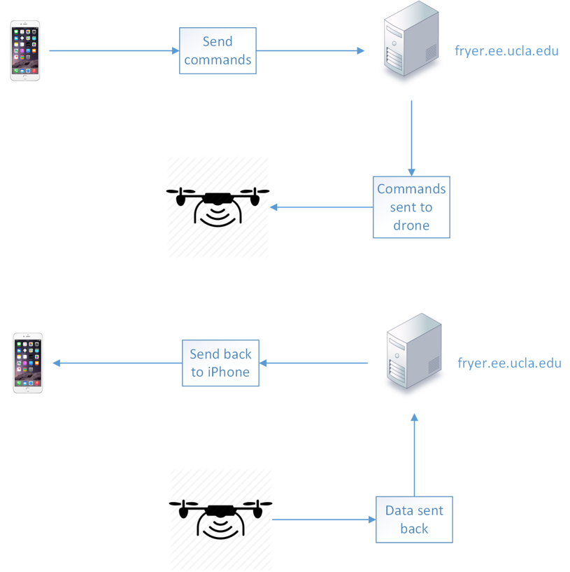
Design Overview
Full-size linux server
MySQL for database
HTTP Restful api
Sockets for video transmitting
Mobile Device
Sending commands
Monitor sensors' status
Notes:
For the software part, we use full-size linux server to

Slide 13
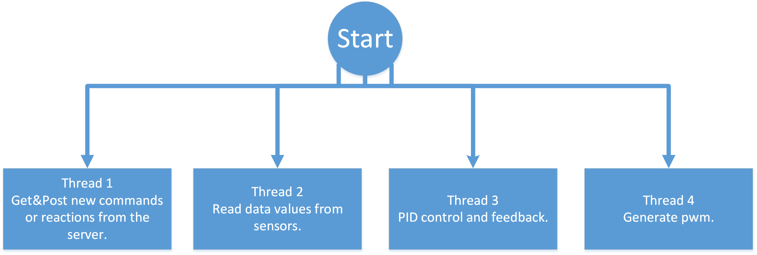
Design Overview
The code is written in C and has more than 4 threads.
The robotic will send/receive commands/data from the server in one thread.
We have separate threads for reading each sensor's data maintain the flying state.
Notes:
For the software part, we use full-size linux server to

Slide 14
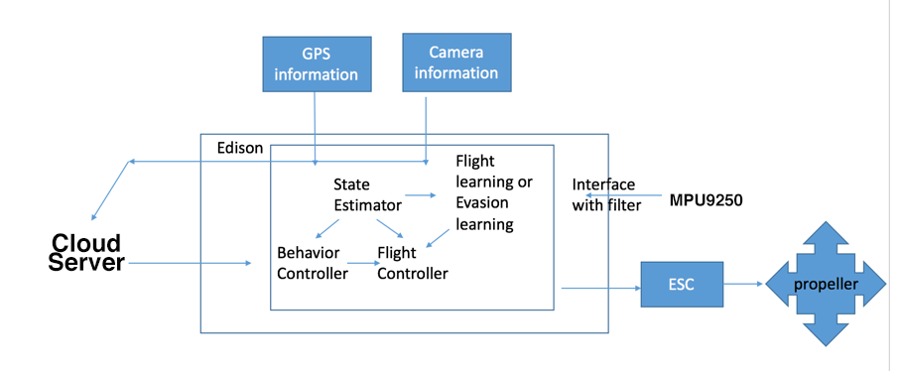
Design Overview: Technical Approach
Detailed Approach: software
Main functionality
information transfer diagram

Slide 15
Design Overview: Technical Approach
Detailed Approach: software
GPS navigation
Get Destination GPS from server
From Adafruit ultimate GPS and gyro get GPS and direction of drone
Compute latitude and longitude distance separately
Notes:
we compute the two distance coninuously, and then find the destination direction.
Our can we firstly turn to the right direction and then start to move forward

Slide 16
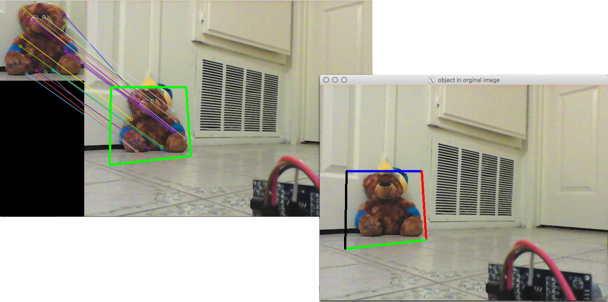
Design Overview: Technical Approach
Detailed Approach: software
Surf algorithm
Using Hessian Matrix to find points of interests
Notes:
The determinant of the Hessian matrix is used as a measure of local change around the point and points are chosen where this determinant is maximal
SURF also uses the determinant of the Hessian for selecting the scale, as it is done by Lindeberg. Given a point p=(x, y) in an image I, the Hessian matrix H(p, σ) at point and scale σ, is defined as follows:

Slide 17
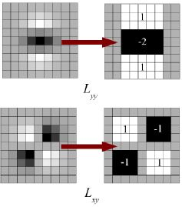
Design Overview: Technical Approach
Detailed Approach: software
Surf algorithm
Using Hessian Matrix to find points of interests
To speed up, using box filter to do approximates
From Haar wavelet responses in both x- and y-directions get the orientation
Compute vector inner product
to find the match point
Notes:
The determinant of the Hessian matrix is used as a measure of local change around the point and points are chosen where this determinant is maximal
SURF also uses the determinant of the Hessian for selecting the scale, as it is done by Lindeberg. Given a point p=(x, y) in an image I, the Hessian matrix H(p, σ) at point and scale σ, is defined as follows:
The Haar wavelet responses in both x- and y-directions within a circular neighbourhood are computed. The obtained responses are weighed by a Gaussian function centered at the point of interest,he dominant orientation is estimated by calculating the sum of all responses within a sliding orientation window of size π/3
This orientation feature can help find the rotated object

Slide 18
Testing and Verification
Test and Verification Plan
App test bench
Drone stability test
IOT algorithm test

Slide 19
Future Plan
Solve the i2c bus freeze problem and fly the drone stably;
Improve our algorithm and attach GPS navigation to the drone;
Fulfill and implement the object detection section to the drone.

Slide 20
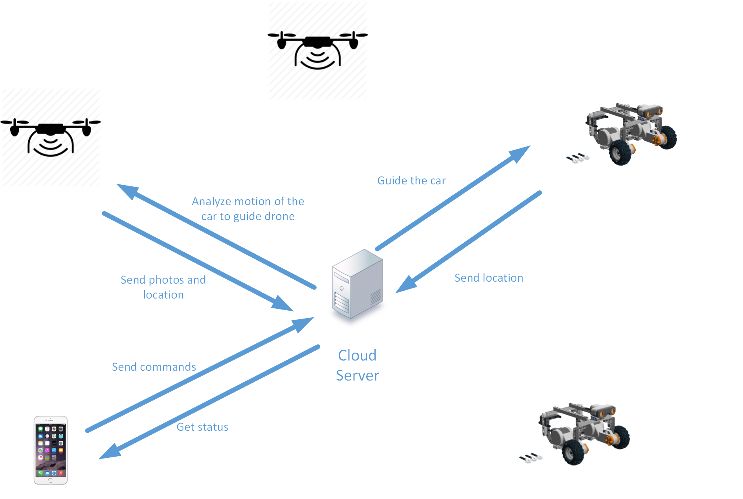
Future Plan
Detailed Approach:
Notes:
This is our plan for doing the car tracking function.
The car is moving and sending its location to the server. When we use iPhone to send commands to begin the tracking program. The drone contacts the server to get the car's location within 10 meters.
When the drone goes to the location, it will use the camera to send images to the server. And using the cloud computing, the server can find out the specific location of the car. And guide the drone to follow the car.

Slide 21
Thank you!
Notes:
especially thank for Professor Kaiser and Chris's help! thx for all your listening.

Slide 22
Team and Responsibilities
Peidong Chen: Server side API design, Edison side function programming with multi-threads, camera images uploading and server side detection.
Yang Yang: IOS app, GPS navigation, figure object detection, Edison side function programming
Jiayu Guo: 3D printing; build the drone; GPS/ultrasonic setup; test the drone
Yitian Hu: 3D printing; build the drone and set up sensors and processor boards; read 9-dof MPU9250 sensor and get sensor fusion data

Slide 23
Resources and References
https://github.com/peidong/drone
An efficient orientation filter for inertial and inertial/magnetic sensor arrays
Sebastian O.H. Madgwick April 30, 2010

